Slide 1
Test Automation Engineering Fundamentals: Java
Module 17: Unit Testing

Slide 2

Module Objectives
At the end of this module, you will be able to:
Define the concepts of unit testing
Describe the purpose and benefits of unit testing
Identify the general principles of test conditions
Apply and utilize the principles of test conditions
Explain the JUnit framework
Perform unit testing using the JUnit framework
Notes:
Key message:
Briefly review the module learning objectives with participants and ask if they have any questions.

Slide 3
Overview of Unit Testing Concepts
A unit is the smallest testable part of an application. In Java, and other object-oriented languages, a unit is a method.
Testing is a way of evaluating software, to determine if requirements and expectations are met, and to detect errors.
Unit testing validates individual units of source code to check if they are working properly.
Unit testing is usually done by the developer, during the building phase of the application.
Although the nature of unit testing may have similarities with debugging, they must not be confused with each other.
Notes:
Key message:
In the real world, unit tests are also known as component test.

Slide 4
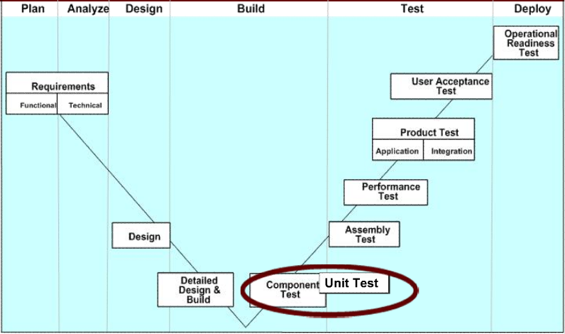
Overview of Unit Testing Concepts (cont.)
Unit Testing in the V-Model
Notes:
Key message:
Unit Testing/ Component Testing is usually done during the build phase of the application as it is being used by the developer to detect errors and other problems early on during the development of the application.

Slide 5
Overview of Unit Testing Concepts (cont.)
Purpose of Unit Testing
Ensures that code is consistent with the detailed design
Ensures that the program can execute normally
Early detection of bugs
Prepares for future test phases
Unit Test should cover
Code
Branches
Paths
Cycles
Notes:
Key message:
Unit test should cover all of the source code, although it is highly improbable and difficult to achieve but it is still ideal.

Slide 6
Overview of Unit Testing Concepts (cont.)
Scope of Unit Testing
For newly generated/developed code
All units/components of the code
For changed/modified code
All the affected units/components of the code along with the units/components that were directly changed
Notes:
Key message:
Unit testing can be used for newly generated/developed code as well as for change or modified code.

Slide 7
Overview of Unit Testing Concepts (cont.)
The technique usually used for unit testing is white-box testing.
White-box testing is a testing strategy wherein the internal workings of a unit/component are studied to create test conditions.
The test environment should be, as much as possible, similar to the real environment.
Notes:
Key message:
One of the most frequently used unit testing technique is called white-box testing.

Slide 8
Overview of Unit Testing Concepts (cont.)
Benefits of Unit Testing
Facilitates Change
Simplifies Integration
Provides living documentation
Serves as a design
Unit testing Phases
Detailed Design Phase
Coding Phase
Unit Test Phase
Notes:
Notes to Instructor:
Explain the benefits and the phases of unit testing in detail.

Slide 9
Overview of Unit Testing Concepts (cont.)
Unit Testing Deliverables
Test Conditions and Expected Results
Test Cycle Control Sheet
Test Data
Test Drivers / Media Programs Document
Test Environment Document
Notes:
Key message:
Test Conditions and Expected Results – Done by the Detail Designer – Outlines the test conditions for the unit test. Expected results are also clearly defined in this document.
Test Cycle Control Sheet – Done by the Detail Designer – Distribute all of the test conditions into appropriate test cycles. Testing operation constraints can be explained in this document.
Test Data – Done by the Detail Designer – Contains the representative data to fulfill the test conditions and test cycle requirements.
Test Drivers / Media Programs Document – Done by the Detail Designer – Need to prepare the media program and corresponding comments for the unfinished related parts of other programs.
Test Environment Document – Done by the detail Designer – The unit test can be conducted in a development environment or an independent Unit Testing environment.

Slide 10
Overview of Unit Testing Concepts (cont.)
Deliverables | Detailed Design Phase | Coding Phase | Unit Test Phase
Test Conditions and Expected Results | Created | Updated | Updated
Test Cycle Control Sheet | Created | Updated | Updated
Test Data Document | Created | Updated | Updated
Test Driver / Media Program Document | Created | Updated | Updated
Test Actual Result |  |  | Created
Test Environment Document | Created | Updated | Updated
Notes:
Key message:
All deliverables are created during the detailed design phase by the detail designer and are constantly updated during the other phases of development. The Test Actual Result (TAR) is created during the unit test phase, usually by the developer, as it is only in this phase where results can be acquired.

Slide 11
Overview of Unit Testing Concepts (cont.)
Limitations of Unit Testing
Checks only the functionality of units; unable to identify system-wide issues
Exposes only the presence of errors, not their absence
Combinatorial problems require significant amount of test code to be written to cover all combinations
Needs rigorous sense of discipline throughout the software development process
More effective when used in conjunction with other software testing activities
Notes:
Notes to Instructor:
Explain the limitations of unit testing.

Slide 12
Writing Test Conditions
A test condition is a statement that defines a constraint that must be satisfied by the program being tested.
Test Condition General Principles
Branch Coverage
Condition Coverage
Loop Coverage
Interface Coverage
Logic Path Coverage
Notes:
Notes to Instructor:
Explain the conditions for unit testing.

Slide 13
Writing Test Conditions (cont.)
Branch Coverage
Test conditions should be developed to cover all logic branches in the function modules. This ensures that no executable statements are missed.
Some conditions that may belong in this category are
IF-ELSE-ENDIF
CASE-WHEN-ENDCASE
WHILE-ENDWHILE
Notes:
Notes to Instructor:
Explain the branch coverage principle of test condition.

Slide 14
Writing Test Conditions (cont.)
Condition Coverage
Test conditions should be developed to make sure that every possible value of every judgment can be executed at least once.
Test conditions that are used are boundary conditions usually for conditions that allow ranges.
IF-ELSE conditions and its combinations belong in this category.
Notes:
Notes to Instructor:
Explain the condition coverage principle of test condition.

Slide 15
Writing Test Conditions (cont.)
Loop Coverage
Test conditions should be developed to cover all possible cases, including the loop being executed only once, or multiple times, or executed maximum times, or even the loop never being executed.
Loop statements such as the FOR, WHILE, DO-WHILE belong in this category.
Notes:
Focus: Writing Test Conditions (cont.)
Content: NA
Notes to Instructor:
Explain the loop coverage principle of test condition.
Transition:
Let’s learn the interface, logic path and other types of principles of test conditions.

Slide 16
Writing Test Conditions (cont.)
Interface Coverage
It should be ensured that the interface for individual program units can work correctly
Logic Path Coverage
All logic paths should be tested during the unit test
Other Types of Coverage
Exception Handling Test
Argument Type Cast Test
Comparison Computing Test
Local Variable Usage Test
Notes:
Notes to Instructor:
Explain the interface coverage, logic path coverage and other types of coverage principles of test condition.
Transition:
Let’s learn about the jUnit as a testing tool.

Slide 17
Using JUnit as a Testing Tool
JUnit is an open source Java testing framework shipped with Eclipse. It is an instance of the xUnit architecture for unit testing frameworks.
JUnit features include:
Assertions for testing expected results
Test fixtures for sharing common test data
Test suites for easily organizing and running tests
Graphical and textual test runners
Notes:
Notes to Instructor:
Explain the JUnit tool in detail.

Slide 18
Using JUnit as a Testing Tool (cont.)
JUnit helps to write code faster while increasing code quality.
JUnit tests check their own results and provide immediate feedback.
JUnit tests increase the stability of software.
JUnit is elegantly simple.
JUnit tests are developer tests.
JUnit tests are written in Java.
Notes:
Key message:
Writing tests with JUnit, allows you to spend less time debugging and provides assurance that the changes you made to your code will actually work. This confidence allows you to be more aggressive about refactoring code and adding new features
Testing isn’t fun if you have to manually compare the expected and actual result of tests, and it slows you down. JUnit tests can be run automatically and can check their own results. When you run tests, you get simple and immediate visual feedback as to whether the tests passed or failed. There's no need to manually comb through a report of test results.
Here are just a few reasons to use JUnit:
JUnit tests allow you to write code faster while increasing quality.
Yes, I know, it sounds counter-intuitive, but it's true! Writing tests with JUnit, allows you to spend less time debugging and provides assurance that the changes you made to your code will actually work. This confidence allows you to be more aggressive about refactoring code and adding new features.

Slide 19
Using JUnit as a Testing Tool (cont.)
This is a hidden slide.
Notes:
Key message
Writing tests should be simple - that's the point! If writing tests is too complex or takes too much time, there's no incentive to start writing tests in the first place.
Without tests, it's easy to become paranoid about refactoring or adding new features because you don't know what might break as a result. With a comprehensive test suite, you can quickly run the tests after changing the code and gain assurances that your changes didn't break anything. If a bug is detected while running tests, the source code is fresh in your mind, so the bug is easily found.
With JUnit, you can quickly write tests that exercise your code and incrementally add tests as the software grows
Once you've written some tests, you want to run them quickly and frequently without disrupting the creative design and development process. With JUnit, running tests is as easy and fast as running a compiler on your code. In fact, you should run your tests every time you run the compiler. The compiler tests the syntax of the code and the tests validate the integrity of the code
JUnit tests check their own results and provide immediate feedback.
JUnit is elegantly simple.

Slide 20
Using JUnit as a Testing Tool (cont.)
This is a hidden slide.
Notes:
Key message:
JUnit tests can be composed into a hierarchy of test suites.
JUnit tests can be organized into test suites containing test cases and even other test suites. The composite behavior of JUnit tests allows you to assemble collections of tests and automatically regression test the entire test suite all at once. You can also run the tests for any layer within the test suite hierarchy.
Writing JUnit tests are inexpensive.
Using the JUnit testing framework, you can write tests cheaply and enjoy the convenience offered by the testing framework. Writing a test is as simple as writing a method that exercises the code to be tested and defining the expected result. The framework provides the context for running the test automatically and as part of a collection of other tests. This small investment in testing will continue to pay you back in time and quality.
JUnit tests increase the stability of software.
The fewer tests you write, the less stable your code becomes. Tests validate the stability of the software and instill confidence that changes haven't caused a ripple-effect through the software. The tests form the glue of the structural integrity of the software.

Slide 21
Using JUnit as a Testing Tool (cont.)
This is a hidden slide.
Notes:
Key message:
JUnit tests are developer tests.
JUnit tests are highly localized tests written to improve a developer's productivity and code quality. Unlike functional tests, which treat the system as a black box and ensures that the software works as a whole, unit tests are written to test the fundamental building blocks of the system from the inside out.
Developers write and own the JUnit tests. When a development iteration is complete, the tests are promoted as part and parcel of the delivered product as a way of communicating, "Here's my deliverable and the tests which validate it."
JUnit tests are written in Java.
Testing Java software using Java tests forms a seamless bond between the test and the code under test. The tests become an extension to the overall software and code can be refactored from the tests into the software under test. The Java compiler helps the testing process by performing static syntax checking of the unit tests and ensuring that the software interface contracts are being obeyed
JUnit is free!

Slide 22
Using JUnit as a Testing Tool (cont.)
A test case is a set of inputs, execution conditions, and expected results, which is used to evaluate a program’s compliance towards a specified requirement.
Tips for creating test cases:
Test results should be quick and easy to determine and understand.
Tests should be self explanatory.
Tests should be valid, unless intentionally testing for errors and/or error-recovery.
Notes:
Key message:
Here are some tips for creating test cases.

Slide 23
Using JUnit as a Testing Tool (cont.)
This is a sample code of a method that adds two numbers, num1 and num2.
public int add(int num1, int num2)
{
return num1 + num2;
}
public void TestAdd()
{
if(add(3,5)==8)
{
System.out.println("Success !");
}
else
{
System.out.println("Oops. Failed!");
}
}
This is a sample unit test case that verifies the result of the method on the top figure.
Notes:
Key message:
Explain the two samples in detail.

Slide 24
Using JUnit as a Testing Tool (cont.)
In JUnit, unit test cases are created by using assert methods.
Assert methods are built in the JUnit framework and are used to determine the compliance of source code to the requirements.
Commonly used assert methods are:
assertTrue(boolean),
assertTrue(String, boolean)
assertEquals(Object, Object)
assertNull(Object)
fail(String)
Notes:
Key message:
Some commonly used Assert Methods are:
assertTrue(boolean)
You can supply any boolean expression to this method
As long as the boolean expression is evaluated as true, the method reports success
If the condition you want to check is evaluated as false, simply prepend the "!" negation operator to your parenthesized expression
assertTrue(String, boolean)
Same as the first form of assertTrue, except that the supplied String is printed if the assertion fails
Most methods have a version of this form with a message string
assertEquals(Object, Object)
Compares the two objects you pass in using the equals( ) method
assertNull(Object)
Succeeds if the Object reference passed in is null. There is also an assertNotNull method
fail(String)
Causes the test to fail, printing out the supplied String

Slide 25
Using JUnit as a Testing Tool (cont.)
This is a generic test case, which prints out a message depending on the outcome of the AddTwoNumbers method.
public void TestAdd()
{
if(add(3,5)==8)
{
System.out.println("Success !");
}
else
{
System.out.println("Oops. Failed!");
}
}
public void TestAdd()
{
assertEquals(8, add( 3 , 5 ));
}
This test case performs the same task as above and shows the results with a red or green bar, instead of string messages.
Notes:
Notes to Instructor:
Explain the above sample and the short JUnit test that does the same function as the code on top in detail.

Slide 26
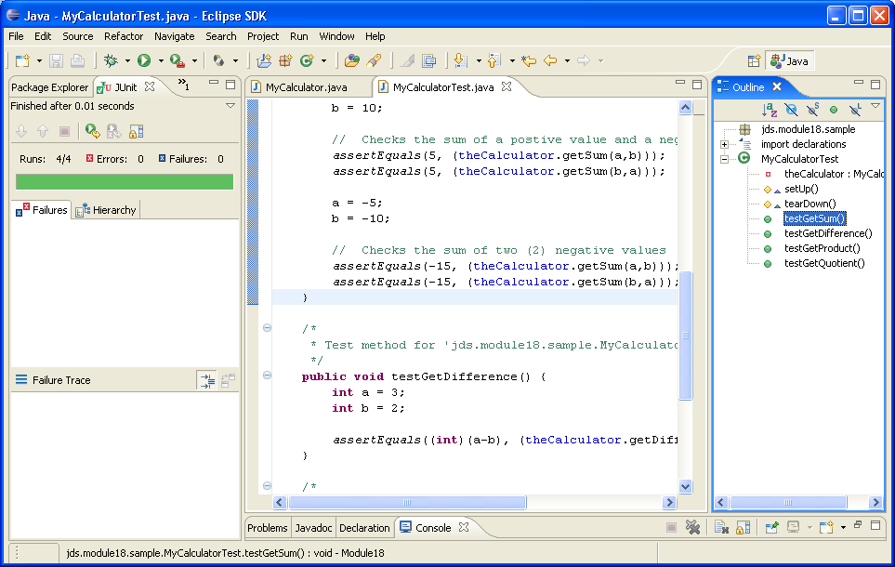
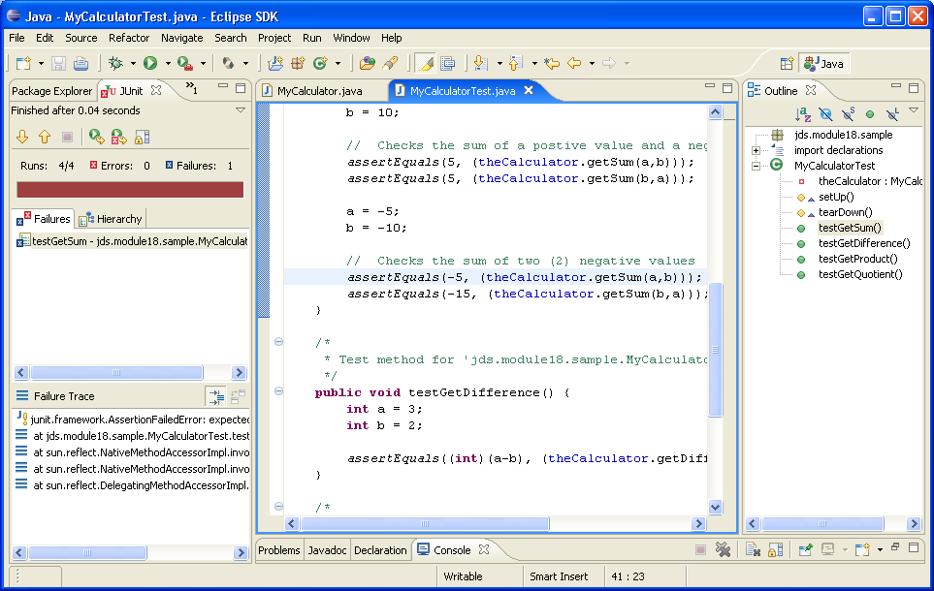
Using JUnit as a Testing Tool (cont.)
Failure…
Success!
Notes:
Key message:
A green bar indicates that the code being tested has passed all test cases in the JUnit.
On the contrary, a red bar indicates that the code being tested has failed one or more test cases. It is best to review both the code and test cases before making changes as the source of the problem may not be the source code itself, but rather typos or incorrect logic in the test cases themselves.

Slide 27
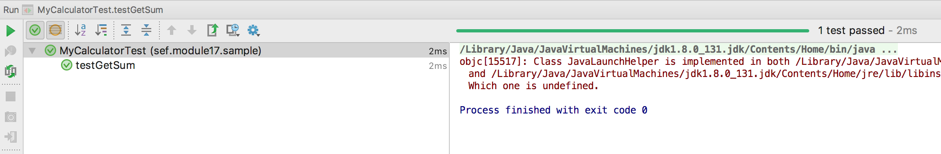
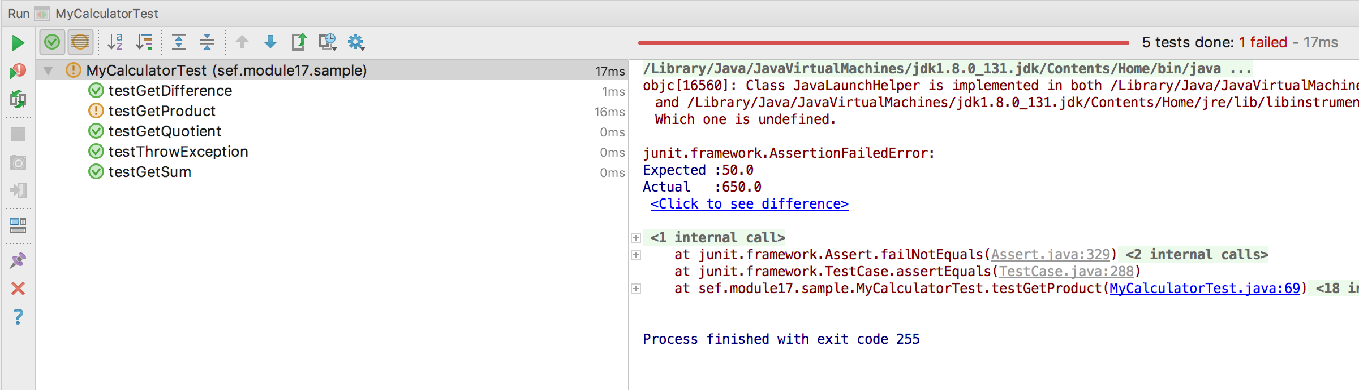
Using JUnit as a Testing Tool (cont.)
Failure...
Success!
Error message
Notes:
Key message:
A green bar indicates that the code being tested has passed all test cases in the JUnit.
On the contrary, a red bar indicates that the code being tested has failed one or more test cases. It is best to review both the code and test cases before making changes as the source of the problem may not be the source code itself, but rather typos or incorrect logic in the test cases themselves.

Slide 28
Using JUnit as a Testing Tool (cont.)
To create a JUnit Test case:
Code the component to be tested
Create a corresponding JUnit test case by right-clicking the component’s source code class
In the pop-up menu choose “New” then choose “JUnit Test Case”
In the JUnit dialog box:
Change the package name to a specific project package standard by appending “test.” to the package name
Select the “setUp” and “tearDown” methods and click “Next”
Choose the methods that will be included in the JUnit test case and click the “Finish” button
Notes:
Key message:
Explain how to write a test case in JUnit in detail.

Slide 29
Using JUnit as a Testing Tool (cont.)
In the JUnit Test Case class, make sure that you have imported all the needed packages to be used, including the package name of the component to be tested.
To execute the test cases:
Right-click Test Case class in the “Package Explorer”
Select “Unit Test”
Choose “Run As”
Notes:
Key message:
Explain how to execute test cases.

Slide 30
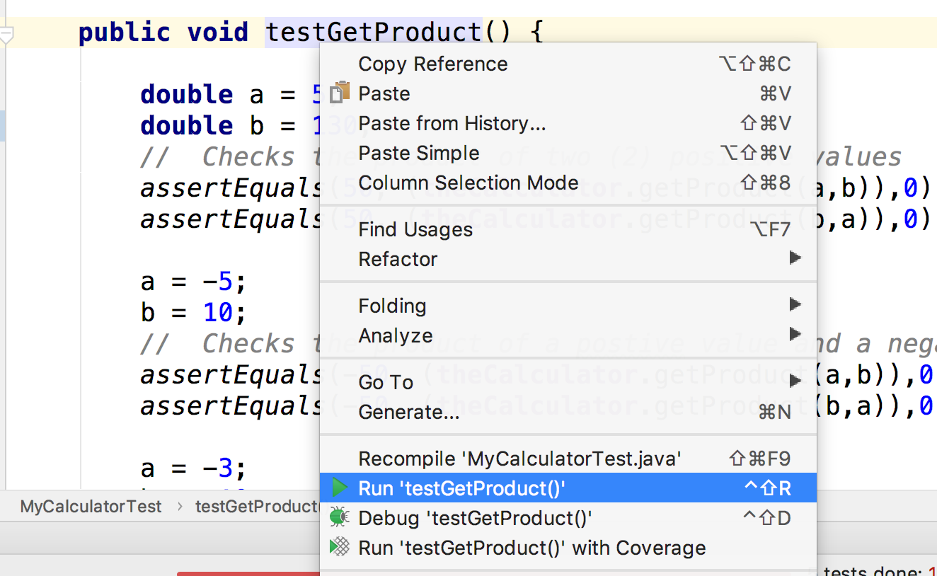
Using JUnit as a Testing Tool (cont.)
To execute the test cases:
Notes:
Key message:
Explain how to execute test cases.

Slide 31
Using JUnit as a Testing Tool (cont.)
In the “setUp” method, it is a good practice to initialize all variables that are to be used in the tests.
The developer can also make use of the “tearDown” method, to explicitly remove/destroy all variables created and used by the test case(s).
Notes:
Key message:
Explain how to initiate test cases.

Slide 32
Using JUnit as a Testing Tool (cont.)
Sample code:
package sef.module18.sample;
public class MyCalculator {
public int getSum(int a, int b){
return a + b;
}
public int getDifference(int a, int b){
return a - b;
}
public double getProduct(double a, double b){
return a * b;
}
public double getQuotient(double a, double b){
return a / b;
}
}
Notes:
Key message:
Use working source code from the path sef.module18.sample.MyCalculator.java to see its working.

Slide 33
Using JUnit as a Testing Tool (cont.)
JUnit Test Case
package sef.module18.sample;
import junit.framework.TestCase;
public class MyCalculatorTest extends TestCase {
private MyCalculator theCalculator;
protected void setUp() throws Exception {
super.setUp();
// Initialize variables to be used here
theCalculator = new MyCalculator();
}
protected void tearDown() throws Exception {
super.tearDown();
}
Notes:
Key message:
Use working source code from:
sef.module18.sample.MyCalculatorTest.java
Though it is not necessary to show this, but it might help to give students an idea that even the smallest code, needs a great amount of test cases depending on the data type and logic of the code. This test case may NOT cover all possible scenarios, it might be a good exercise for the students to identify other scenarios, including scenarios that can not be detected by test cases.

Slide 34
Using JUnit as a Testing Tool (cont.)
public void testGetSum() {
int a = 5;
int b = 10;
// Checks the sum of two (2) positive values
assertEquals(15, (theCalculator.getSum(a,b)));
assertEquals(15, (theCalculator.getSum(b,a)));
a = -5;
b = 10;
// Checks the sum of a postive value and a negative value
assertEquals(5, (theCalculator.getSum(a,b)));
assertEquals(5, (theCalculator.getSum(b,a)));
a = -5;
b = -10;
// Checks the sum of two (2) negative values
assertEquals(-15, (theCalculator.getSum(a,b)));
assertEquals(-15, (theCalculator.getSum(b,a)));
}
i
Refer to the MyCalculator.getSum(int, int) sample code.
Notes:
Key message:
Explain the test method for 'sef.module18.sample.MyCalculator.getSum(int, int)'

Slide 35
Using JUnit as a Testing Tool (cont.)
public void testGetDifference() {
int a = 3;
int b = 2;
// Checks if b is lesser than a
assertEquals(1, (theCalculator.getDifference(a,b)));
// Checks if b is greater than a
assertEquals(-1, (theCalculator.getDifference(b,a)));
a = 5;
b = -4;
// Checks if negative value is subtracted from positive value
assertEquals(9, (theCalculator.getDifference(a,b)));
// Checks if positive value is subtracted from negative value
assertEquals(-9, (theCalculator.getDifference(b,a)));
a = -10;
b = -5;
// Checks if negative value is subtracted from negative value: a > b
assertEquals(-5, (theCalculator.getDifference(a,b)));
// Checks if negative value is subtracted from negative value: b < a
assertEquals(5, (theCalculator.getDifference(b,a)));
}
i
Refer to MyCalculator.get(Difference (int, int) sample code.
Notes:
Key message:
Explain the test method for 'sef.module18.sample.MyCalculator.getDifference(int, int)'

Slide 36
Using JUnit as a Testing Tool (cont.)
public void testGetProduct() {
double a = 5;
double b = 10;
// Checks the product of two (2) positive values
assertEquals(50, (theCalculator.getProduct(a,b)),0);
assertEquals(50, (theCalculator.getProduct(b,a)),0);
a = -5;
b = 10;
// Checks the product of a positive value and a negative value
assertEquals(-50, (theCalculator.getProduct(a,b)),0);
assertEquals(-50, (theCalculator.getProduct(b,a)),0);
a = -3;
b = -10;
// Checks the product of two (2) negative values
assertEquals(30, (theCalculator.getProduct(a,b)),0);
assertEquals(30, (theCalculator.getProduct(b,a)),0);
}
i
Refer to MyCalculator.getProduct (double, double) sample code.
Notes:
Key message:
Explain the test method for 'sef.module18.sample.MyCalculator.getProduct(double, double)'

Slide 37
Using JUnit as a Testing Tool (cont.)
public void testGetQuotient() {
double a = 10; double b = 5;
// Checks if b is lesser than a
assertEquals(2, (theCalculator.getQuotient(a,b)),0);
// Checks if b is greater than a
assertEquals(0.5, (theCalculator.getQuotient(b,a)),0);
a = 9; b = -3;
// Checks if positive value is divided with negative value
assertEquals(-3, (theCalculator.getQuotient(a,b)),0);
// Checks if negative value is divided with positive value
assertEquals(-0.33, (theCalculator.getQuotient(b,a)),0.007);
a = -10; b = -5;
// Checks if negative value is divided with negative value: a > b
assertEquals(2, (theCalculator.getQuotient(a,b)),0);
// Checks if negative value is divided with negative value: b < a
assertEquals(0.5, (theCalculator.getQuotient(b,a)),0);
}
}
i
Refer to MyCalculator.getQuotient (double, double) sample code.
Notes:
Key message:
Explain the test method for 'sef.module18.sample.MyCalculator.getQuotient(double, double)'

Slide 38

Activity – Part 1
Open your SEF workspace in Eclipse.
In the package explorer, navigate to the following package sef.module17.activity.
Open the following class:
EmployeeJDBC.java
Create TCERs for this class. Base your TCERs on the methods written in this class. Ensure that all scenarios are covered.
Notes:
Key Message(s):
Open your SEF workspace in Eclipse.
In the package explorer, navigate to the following package sef.module17.activity.
Open the following class:
EmployeeJDBC.java
Create TCERs for this class. Base your TCERs on the methods written in this class. Ensure that all scenarios are covered.
Additional Information: NA

Slide 39
Activity – Part 2
Open your SEF workspace in Eclipse.
In the package explorer, navigate to the following package sef.module17.activity.
Create JUnit Test Cases for EmployeeJDBC.java:
Based on the TCERs you created in activity part 1, create the test methods.
Right-click on the Test class, select ‘Run As’->’JUnit Test’ and hope for a green bar!
If the JUnit test returns a red, check your code and keep working on it until you get a green bar.
Notes:
Key Message(s):
The students should create test methods to cover both positive and negative scenarios.
Example test methods:
testFindEmployeebyId_MatchFound
testFindEmployeebyId_NoMatchFound
Open your SEF workspace in Eclipse.
In the package explorer, navigate to the following package sef.module17.activity.
Create JUnit Test Cases for EmployeeJDBC.java:
Based on the TCERs you created in activity part 1, create the test methods.
Right click on the Test class, select ‘Run As’->’JUnit Test’ and hope for a green bar!
If the JUnit test returns a red, check your code and keep working on it until you get a green bar.

Slide 40

Questions and Comments
What questions or comments do you have?
Notes:
Key Message(s): NA
Additional Information:
Ask participants for any questions or comments they may have.
With this, we have completed this module!

